Slide 1


Operating Model and Organization Design Toolkit
Overview and Approach

Slide 2
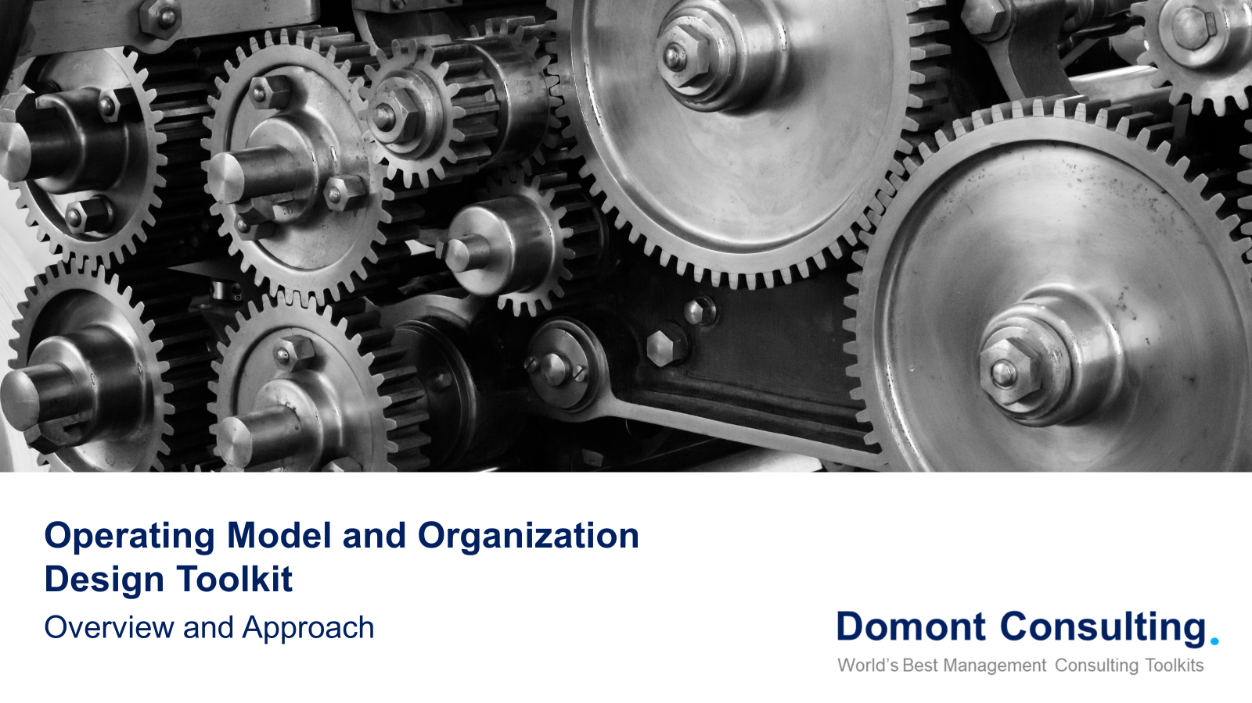
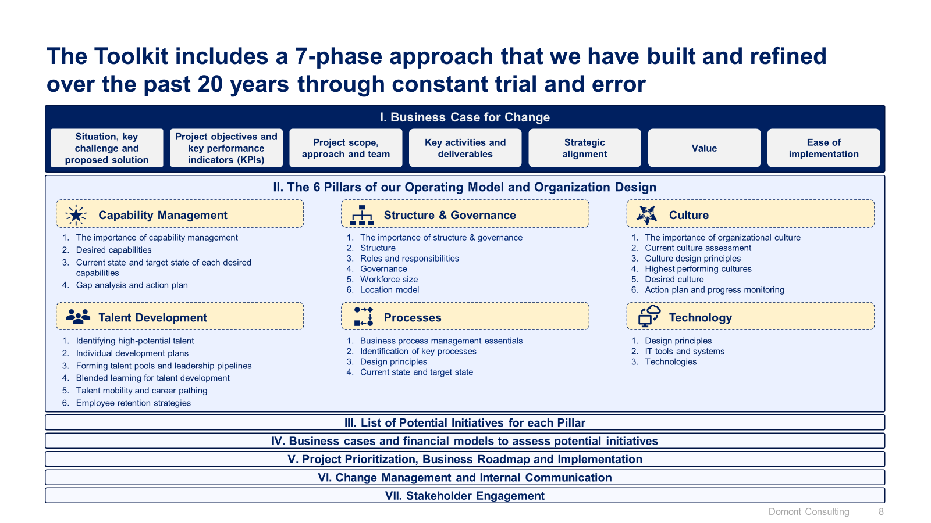
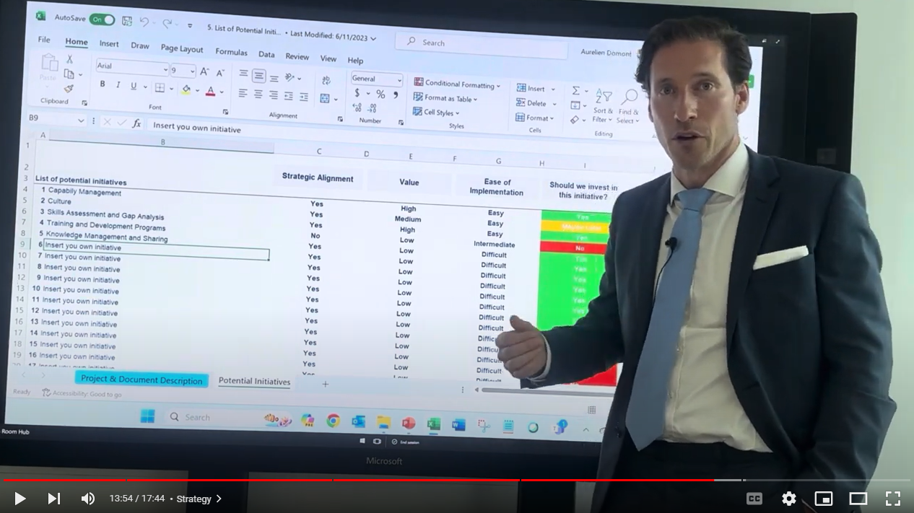
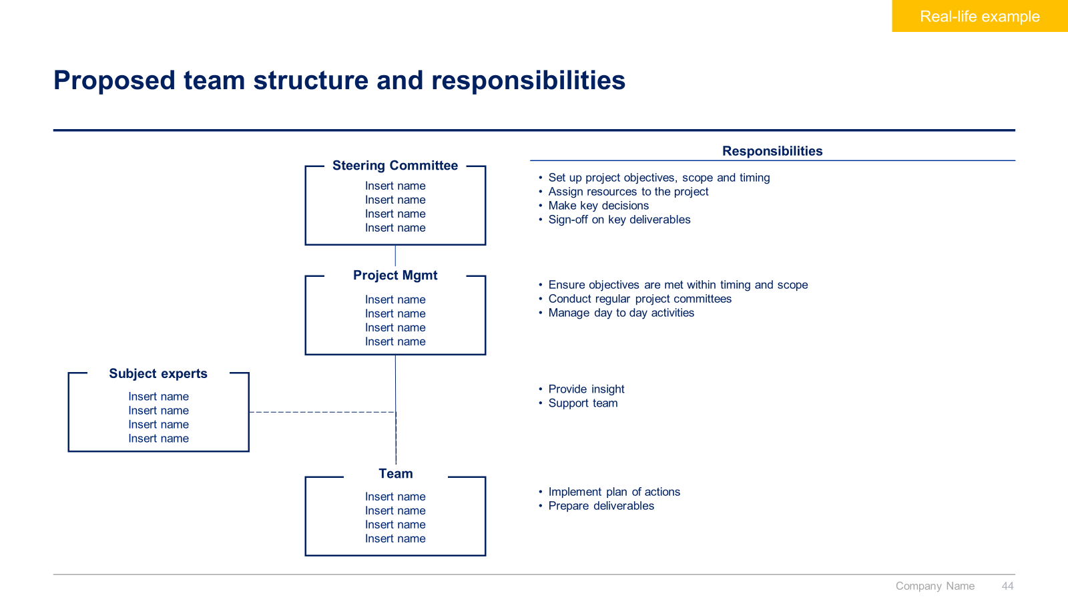
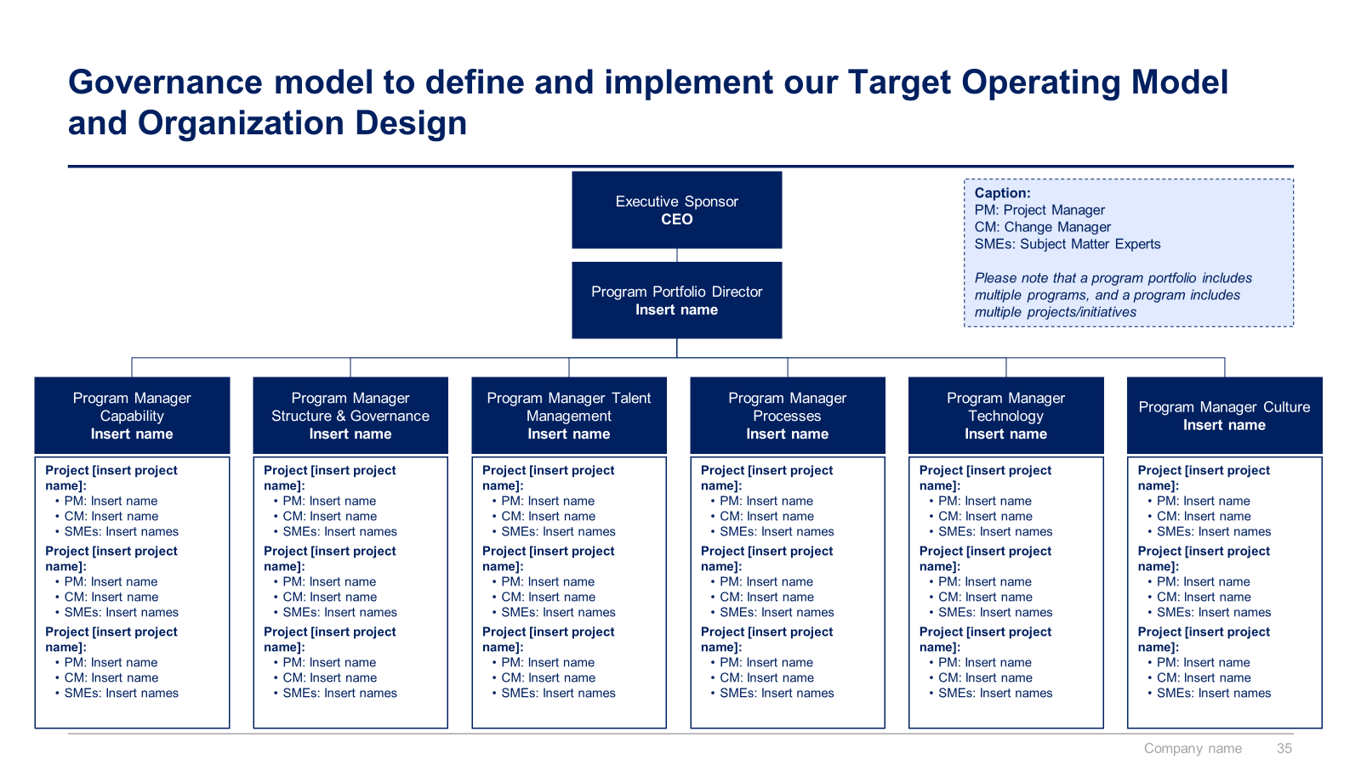
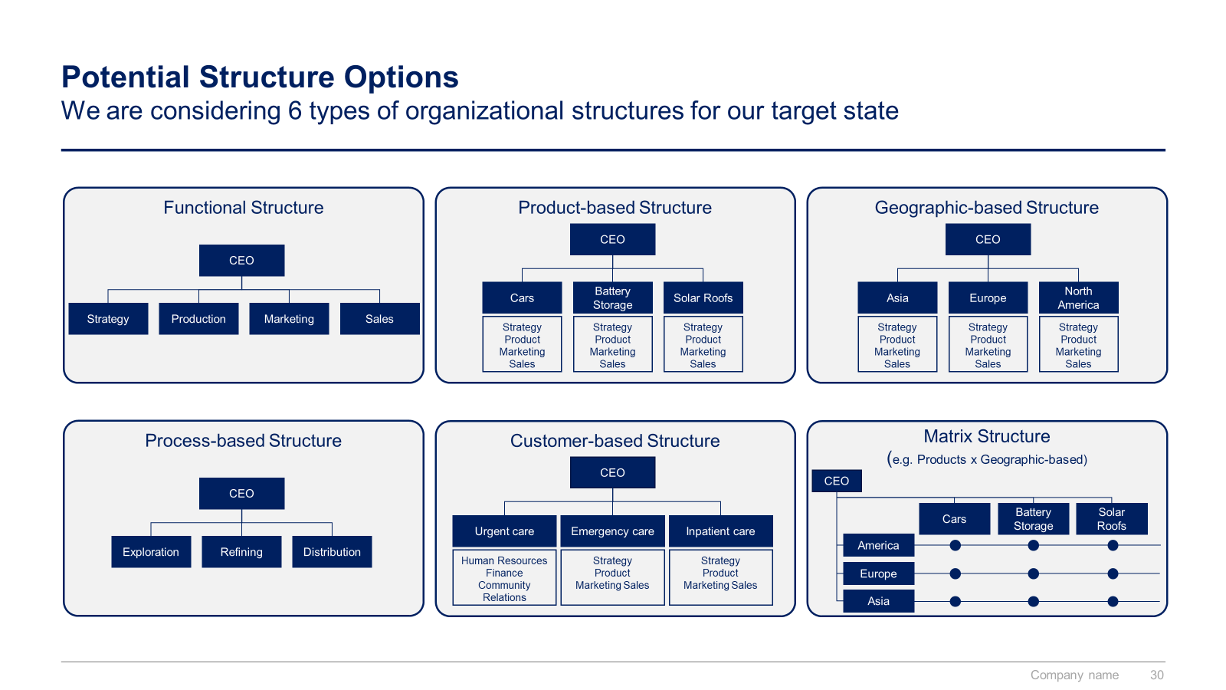
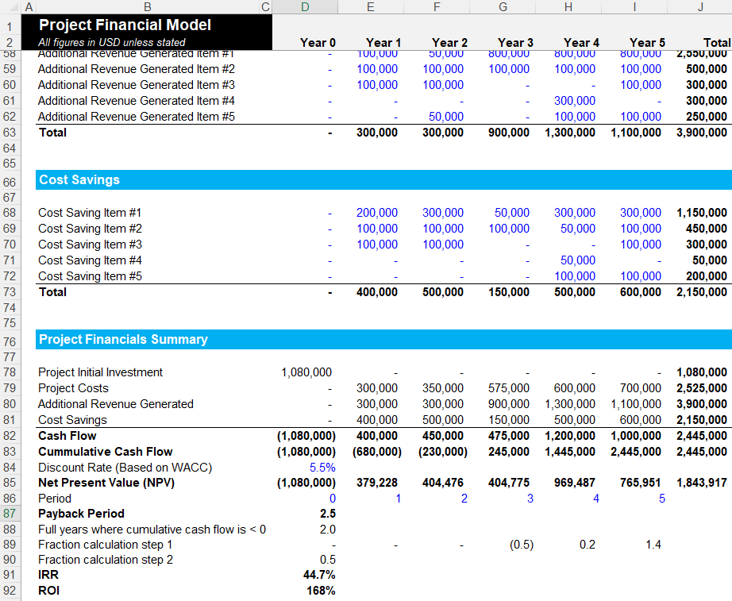
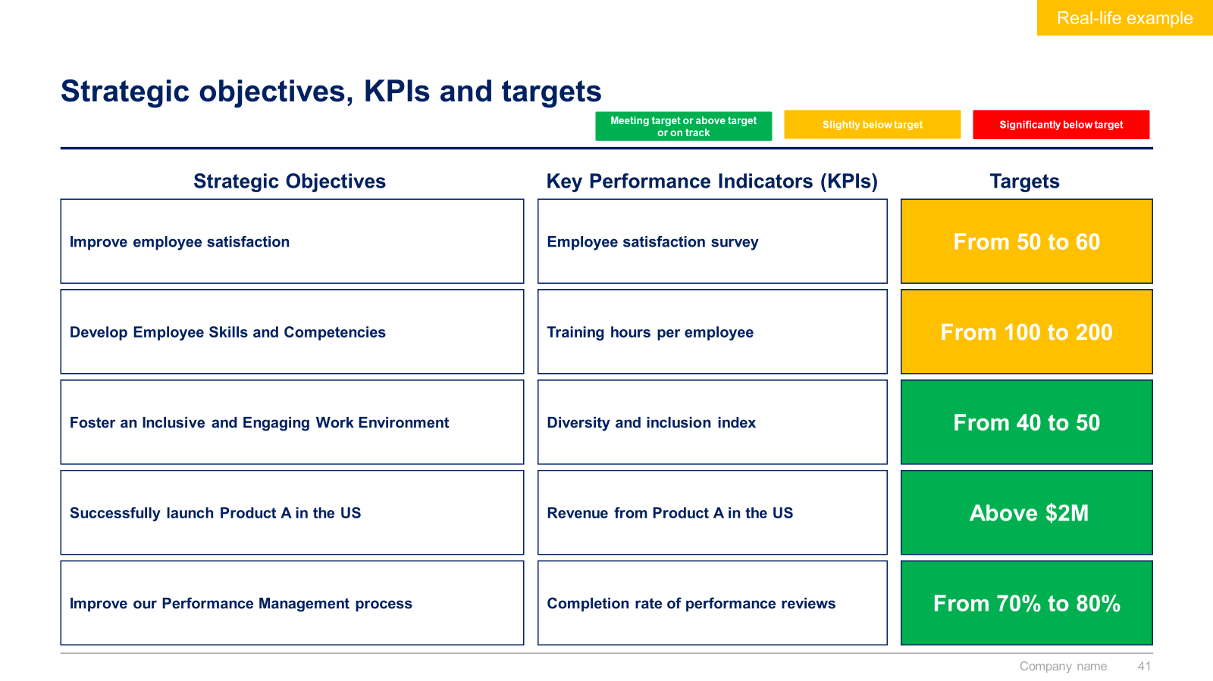
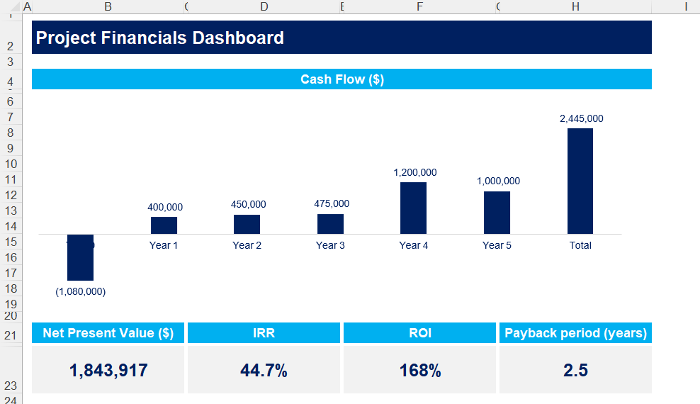

Slide 3


Introduction
This Toolkit was created by ex-McKinsey, Deloitte and BCG Management Consultants after 4,000+ hours of work. It shares our combined 100+ years of experience advising executive teams around the world. It includes all the Frameworks, Best Practices & Templates required to successfully implement an operating model and organization design initiative, and make your strategy happen.
Join the 200,000+ Executives, Consultants & Entrepreneurs who are already leveraging our Management Consulting Toolkits to improve the performance of their organization and boost their own career.
If you have any questions, send us an email at support@domontconsulting.com and one of our ex-McKinsey, Deloitte & BCG Management Consultants will get back to you within 2 business days.
Aurelien Domont
Management Consultant
Domont Consulting Managing Director

Slide 4
Context: Having a great operating model and organization design is more important than ever
In these times of economic turbulence, disruptive technology, globalization and unprecedentedly fierce competition, having a great operating model and organization design is more important than ever.
A great operating model and organization design will help you:
Make your strategy happen
Boost your company’s performance
Adapt to changing conditions
Change the trajectory of your business
Improve coordination and decision-making
Improve risk management
Companies without the right operating model and organization design often experience the following challenges:
Operational inefficiencies as people expend effort in areas not aligned with the strategic plan
Ambiguity around accountabilities, roles and responsibilities, slowing the decision-making process
Low interaction and integration between divisional units and functional areas, as it is unclear to people how they should cross these implicit boundaries
Increased or sustained operating risks due to the absence of clear principles, roles, responsibilities and processes

Slide 5
Problem: Fewer than half of the reorganization efforts are successful
Reorganization initiatives’ ability to reach value creation objectives
Key insights:
In a survey conducted by The Boston Consulting Group, almost 80% of the respondent companies reported under-going a recent reorganization exercise.
However, the survey respondents rated fewer than half of the reorganization efforts as successful. The underlying reason for such a low success rate was that all too often, the companies’ leaders relied on complex organizational frameworks that have become outmoded and ineffective in today’s business environment.
Success rate
Failure rate
Source: HBR and New York Times

Slide 6











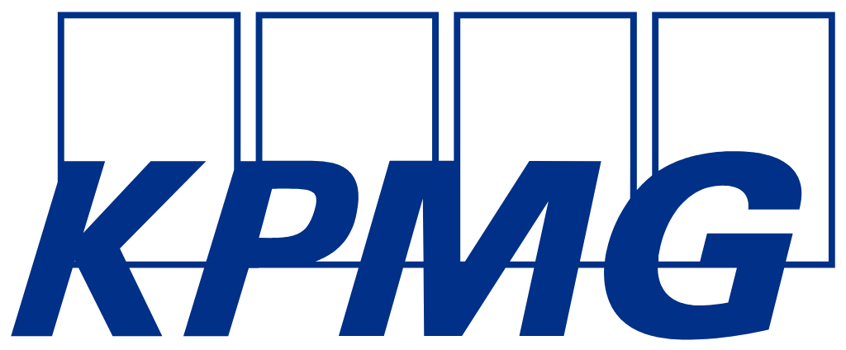
Solution: Our ex-McKinsey, Deloitte & BCG consultants created a Toolkit to help you reach your value creation objectives
What’s inside the Toolkit?
Who created the Toolkit?
The Toolkit was created by former McKinsey, Deloitte & BCG management consultants.
Best Practices
Frameworks
Number of professionals leveraging our Toolkits
Advice from
tier-1 Management Consultants
Tools
There are 200,000+ Executives, Consultants & Entrepreneurs leveraging our Toolkits to improve the performance of their organization.
Real-life Examples
Templates
Trusted by small and large organizations
Video Training
Step-by-step Tutorials

Slide 7
Our Toolkit will help you fulfill multiple objectives
The Operating Model and Organization Design Toolkit includes frameworks, tools, templates, tutorials, real-life examples, video training, and best practices to help you:
Make your strategy happen and boost your company’s performance
Successfully implement an operating model and organization design initiative with our simple and comprehensive 7-phase approach
(I) Carry out your business case for change: (1) Situation, key challenge and proposed solution, (2) Objectives and key performance indicators (KPIs), (3) Project scope, approach and team, (4) Key activities and deliverables, (5) Key Risks and Mitigation Strategies, (6) Strategic alignment, (7) Value: project initial investment, project costs, additional revenue generated, cost savings, cash flows and net present value, (8) Ease of implementation
(II) Define your operating model and organization design: (1) Capability management, (2) Structure and governance, (3) Culture, (4) Talent management, (5) Processes, (6) Technology
(III) List your potential initiatives for each pillar
(IV) Create your business cases and financial models to assess potential initiatives
(V) Prioritize, plan and implement your projects: (1) Project prioritization, (2) Business roadmap, (3) Governance, (4) Dashboards, (5) Project implementation: agile methodology, design thinking and traditional methodology, (6) Continuous improvement (7) Post projects evaluation and lessons learnt, (8) Post program evaluation and lessons learnt
(VI) Define and implement your change management strategy, internal communication strategy, and stakeholder engagement strategy: (1) Change management strategy, (2) Change management plans, (3) Implementation, tracking and progress management, (4) Effective communication
(VII) Create strategic dashboards: (1) Annual, quarterly and monthly overall performance dashboards, (2) Revenue and profit actuals and estimates, (3) Sales and cost breakdown analysis, (4) Three financial statement model, (5) Other common charts

Slide 8

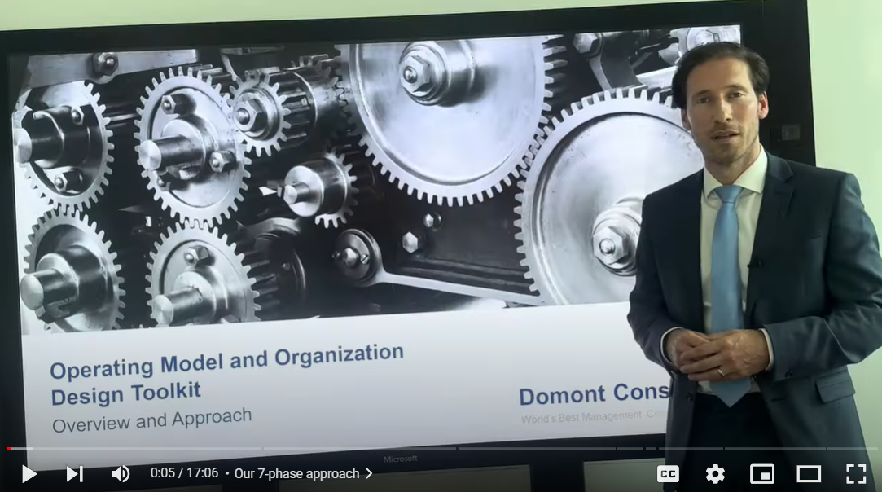
Video demonstration of the Operating Model and Organization Design Toolkit
Video Demo Access
Video Demo Visual
Select “Slide Show” mode and then click on the link below or on the image on the right to access this video demo.
You can also access the video by copy pasting the following URL in your browser:
https://youtu.be/bSbI4iiKQ9Y

Slide 9







The Operating Model and Organization Design Toolkit focuses on 6 components that will help you make your strategy happen
Strategy
Operating Model and Organization Design
This is how you make your strategy happen
Capability Management
Structure & Governance
Culture
Talent Development
Processes
Technology

Slide 10
The Toolkit includes a 7-phase approach that we have built and refined over the past 20 years through constant trial and error
I. Business Case for Change
Situation, key challenge and proposed solution
Objectives and key performance indicators (KPIs)
Project scope, approach and team
Key activities and deliverables
Key Risks and Mitigation Strategies
Strategic
alignment
Value
Ease of implementation
II. The 6 Pillars of our Operating Model and Organization Design
Capability Management
Structure & Governance
Culture
The importance of capability management
Desired capabilities
Current state and target state of each desired capabilities
Gap analysis and action plan
The importance of structure & governance
Structure
Roles and responsibilities
Governance
Workforce size
Location model
The importance of organizational culture
Current culture assessment
Culture design principles
Highest performing cultures
Desired culture
Action plan and progress monitoring
Talent Development
Processes
Technology
Talent assessment
Required competencies
Individual development plans
Effective training programs
Talent mobility and career pathing
Employee retention strategies
Succession plan
Business process management essentials
Identification of key processes
Design principles
Current state and target state
Design principles
IT tools and systems
Technologies
III. List of Potential Initiatives for each Pillar
IV. Business Cases and Financial Models to assess Potential Initiatives
V. Project Prioritization, Business Roadmap and Implementation
VI. Change Management, Internal Communication and Stakeholder Engagement
VII. Strategic Dashboards

Slide 11
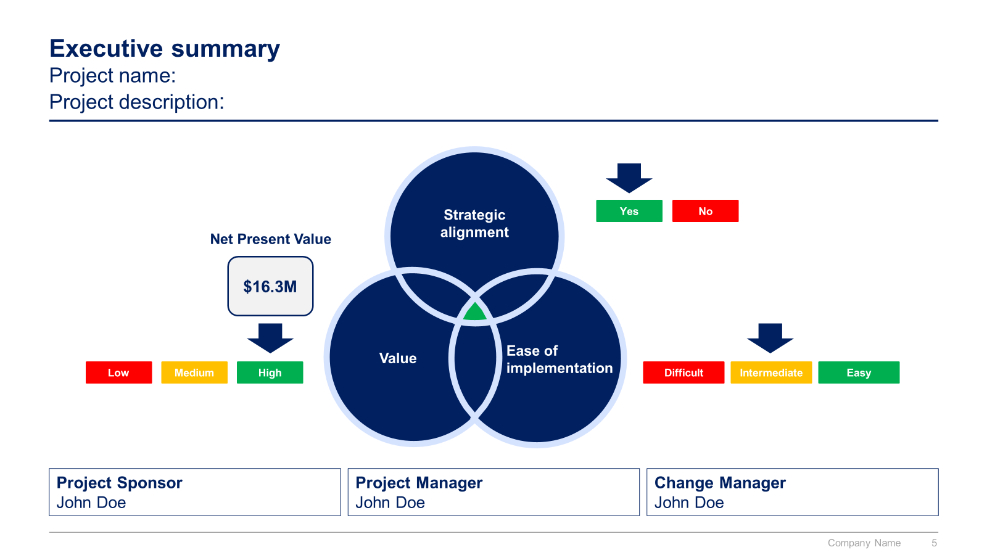
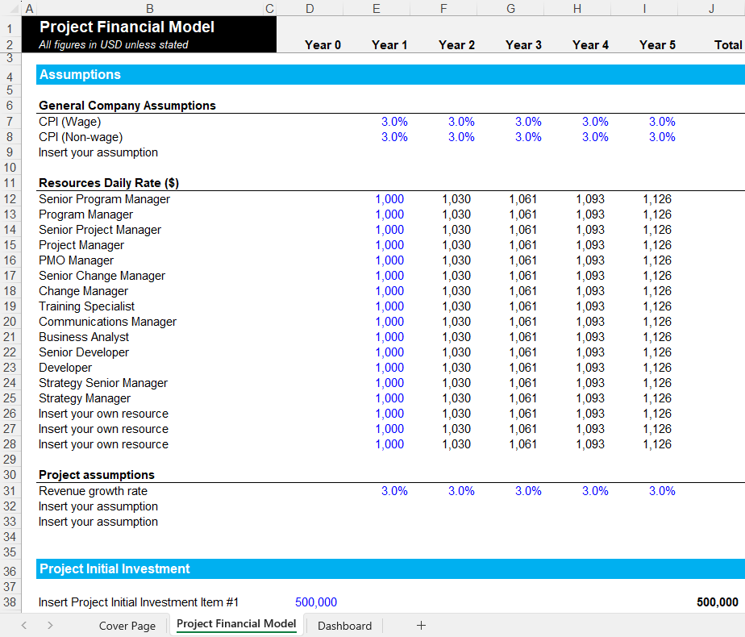
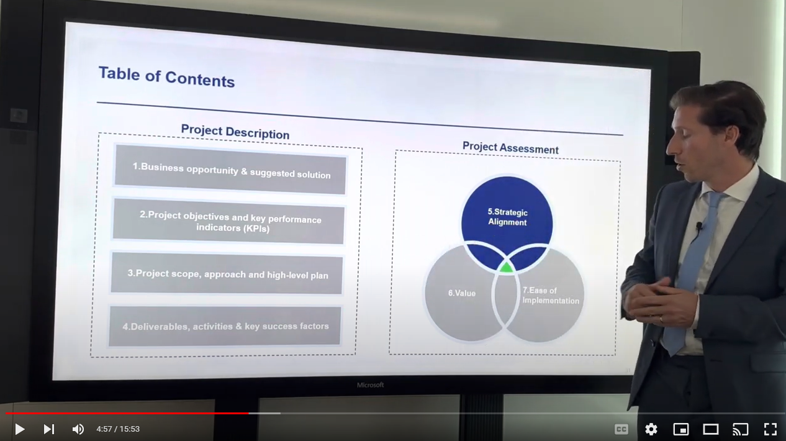
Small preview of the phase 1 ‘Business Case for Change’

Slide 12
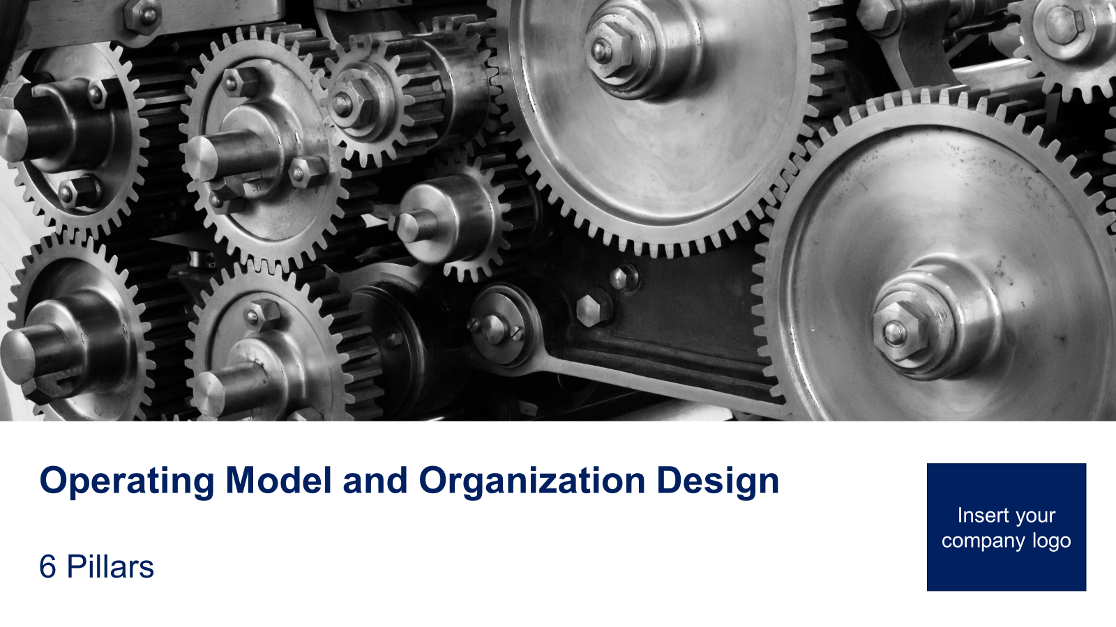
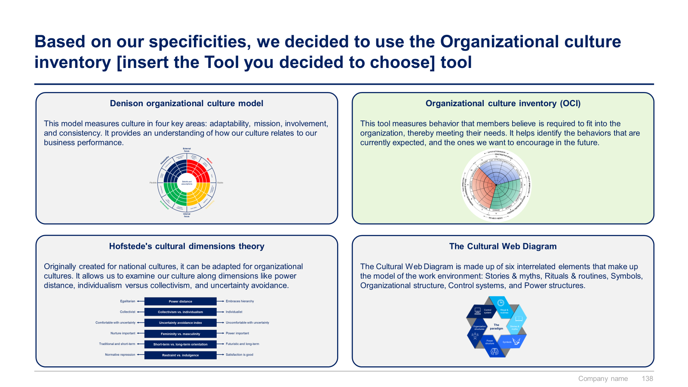
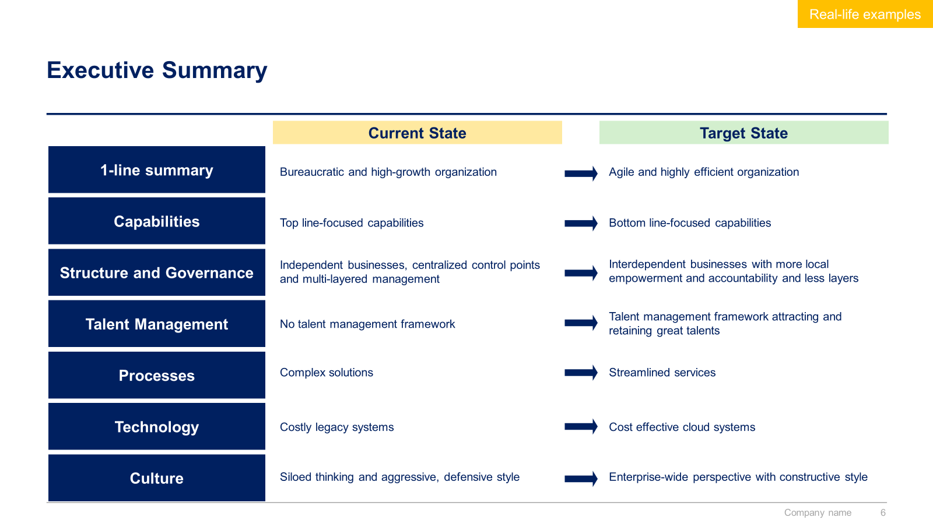
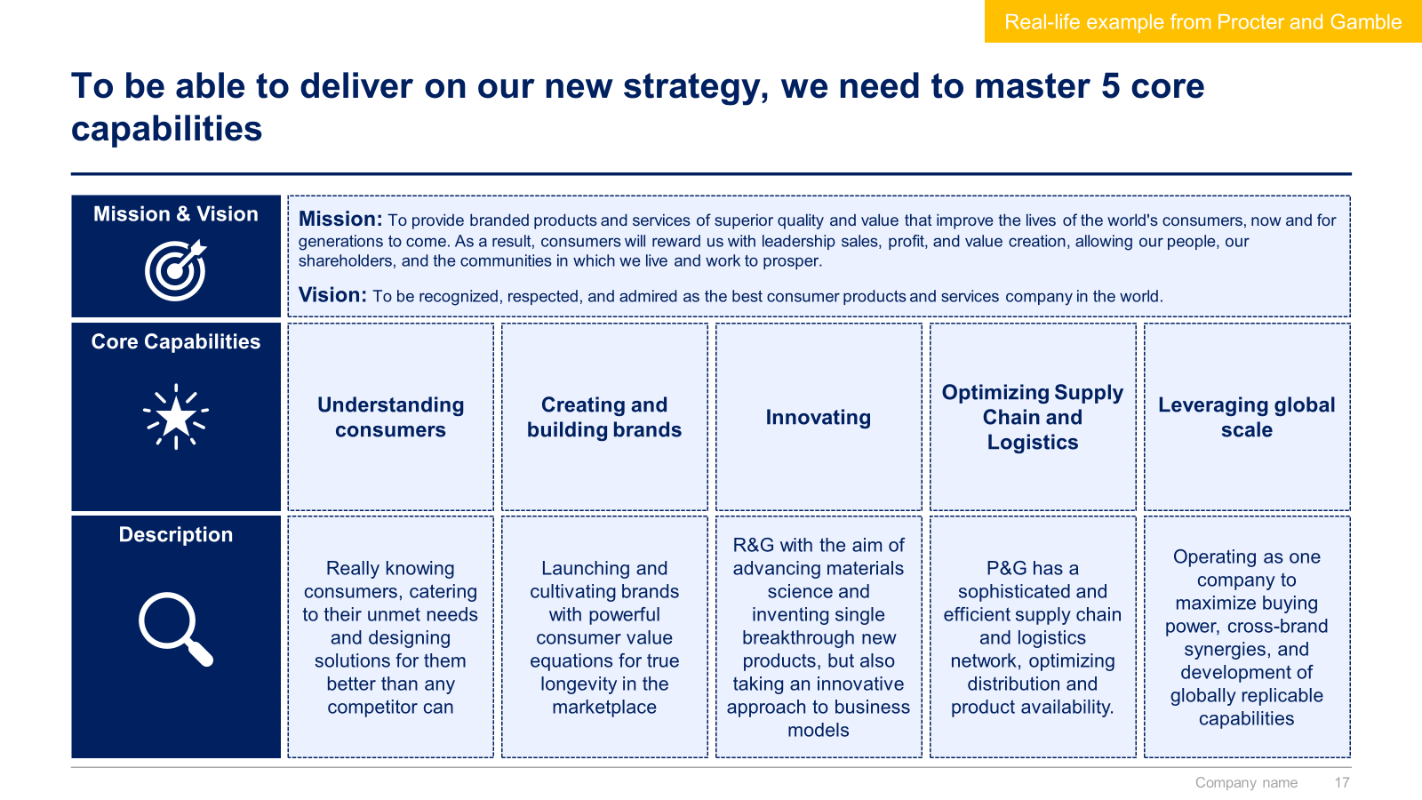
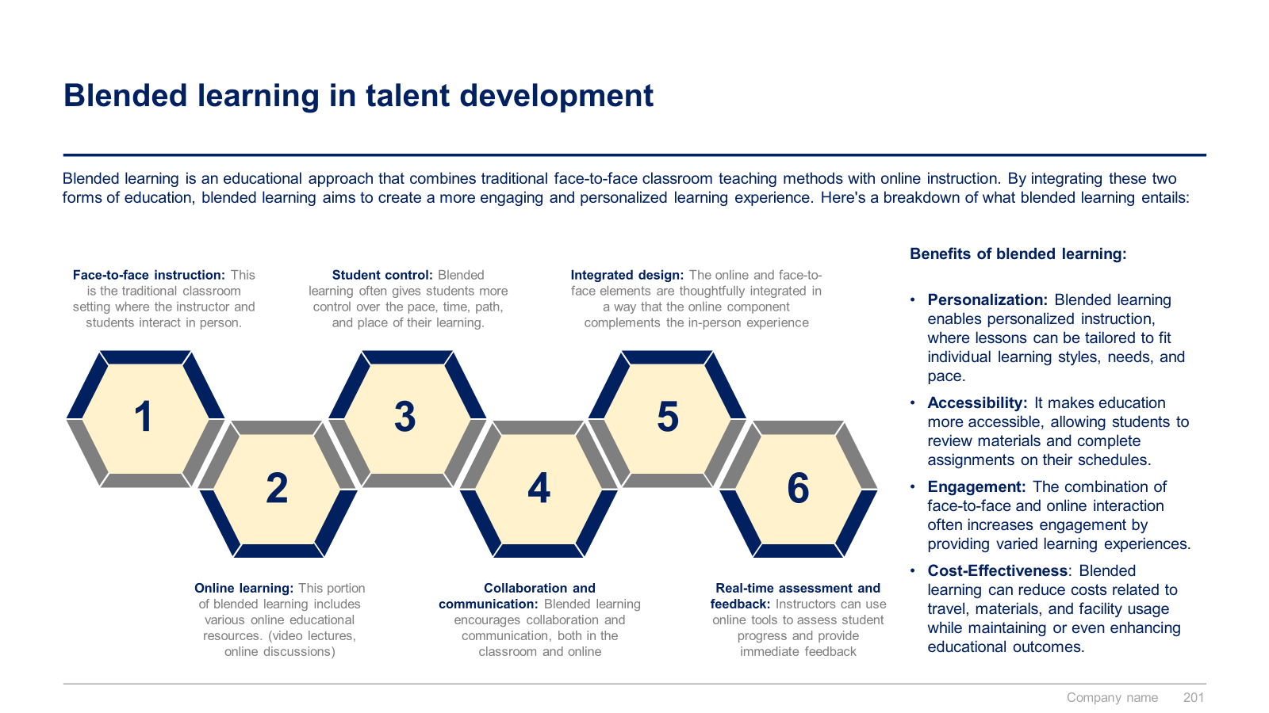
Small preview of the phase 2 ‘Operating Model and Organization Design 6 Pillars’

Slide 13
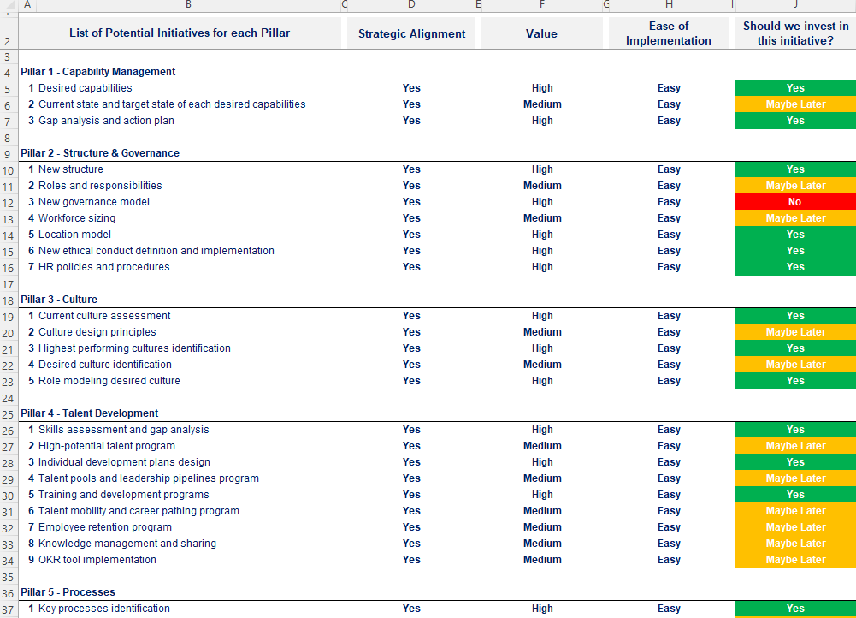
Small preview of the phase 3 ‘List of Potential Initiatives for each Pillar’

Slide 14
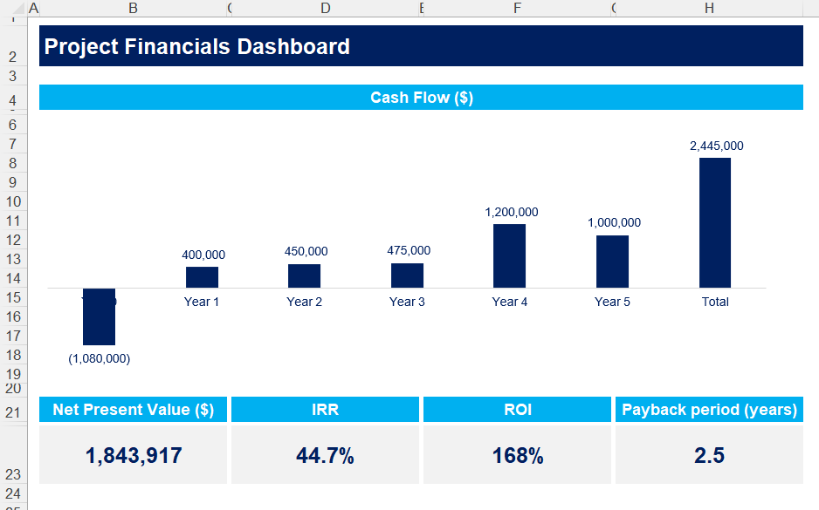
Small preview of the phase 4 ‘Business cases and financial models to assess potential initiatives’

Slide 15
Small preview of the phase 5 ‘Project Prioritization, Business Roadmap and Implementation’

Slide 16
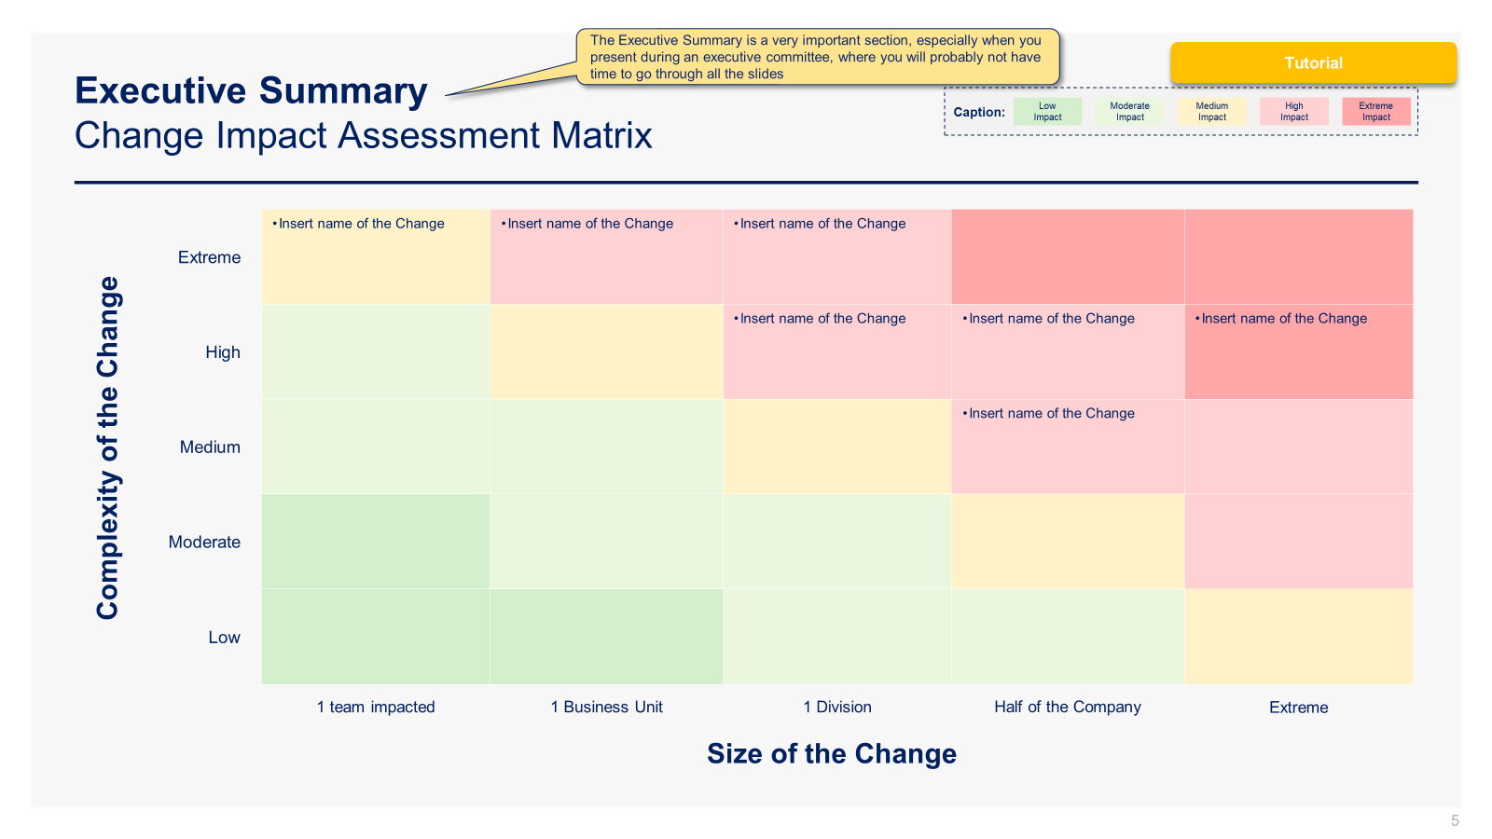
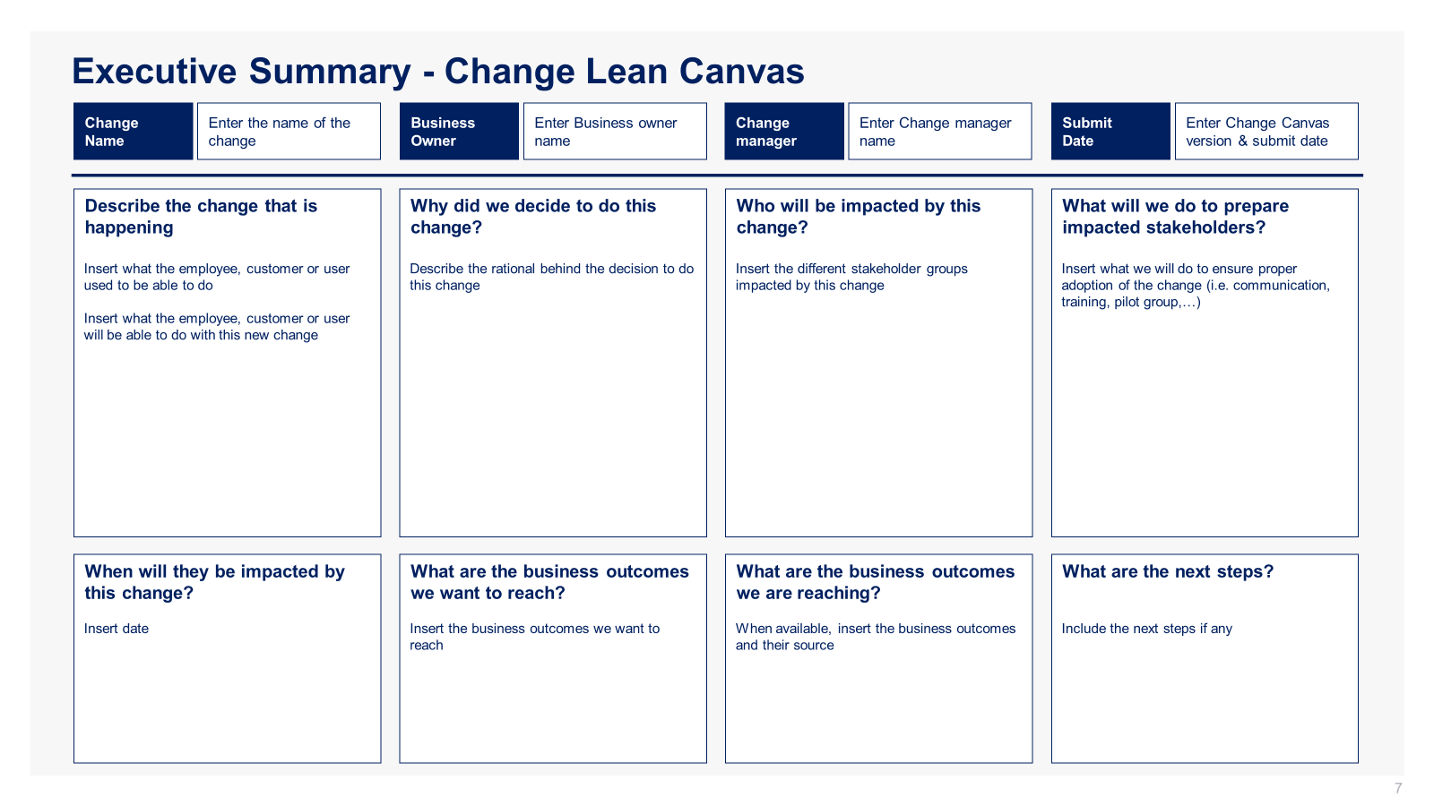
Small preview of the phase 6 ‘Change Management, Internal Communication and Stakeholder Engagement’

Slide 17
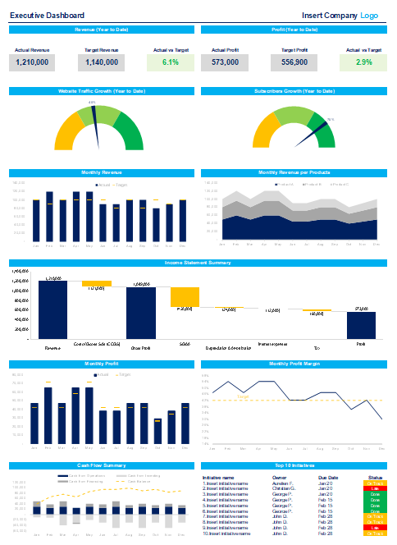
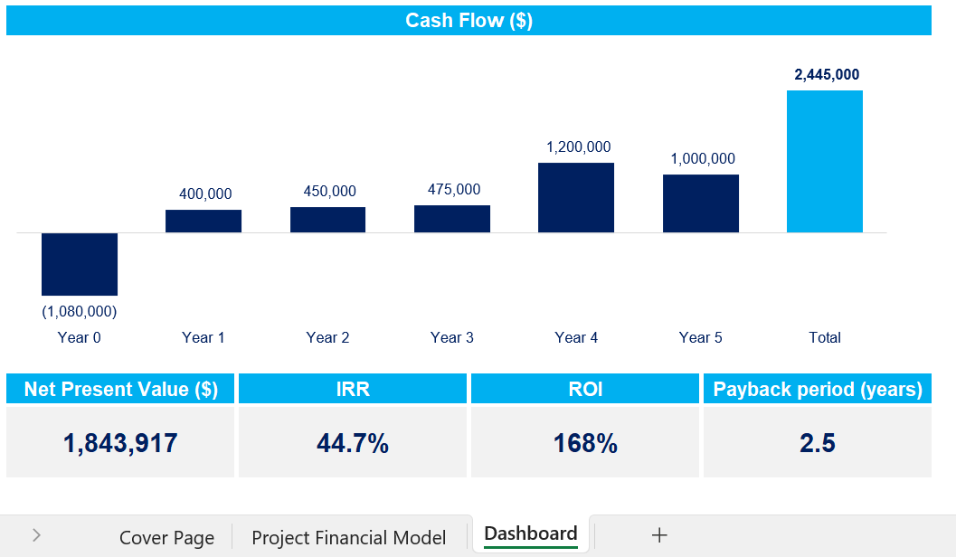
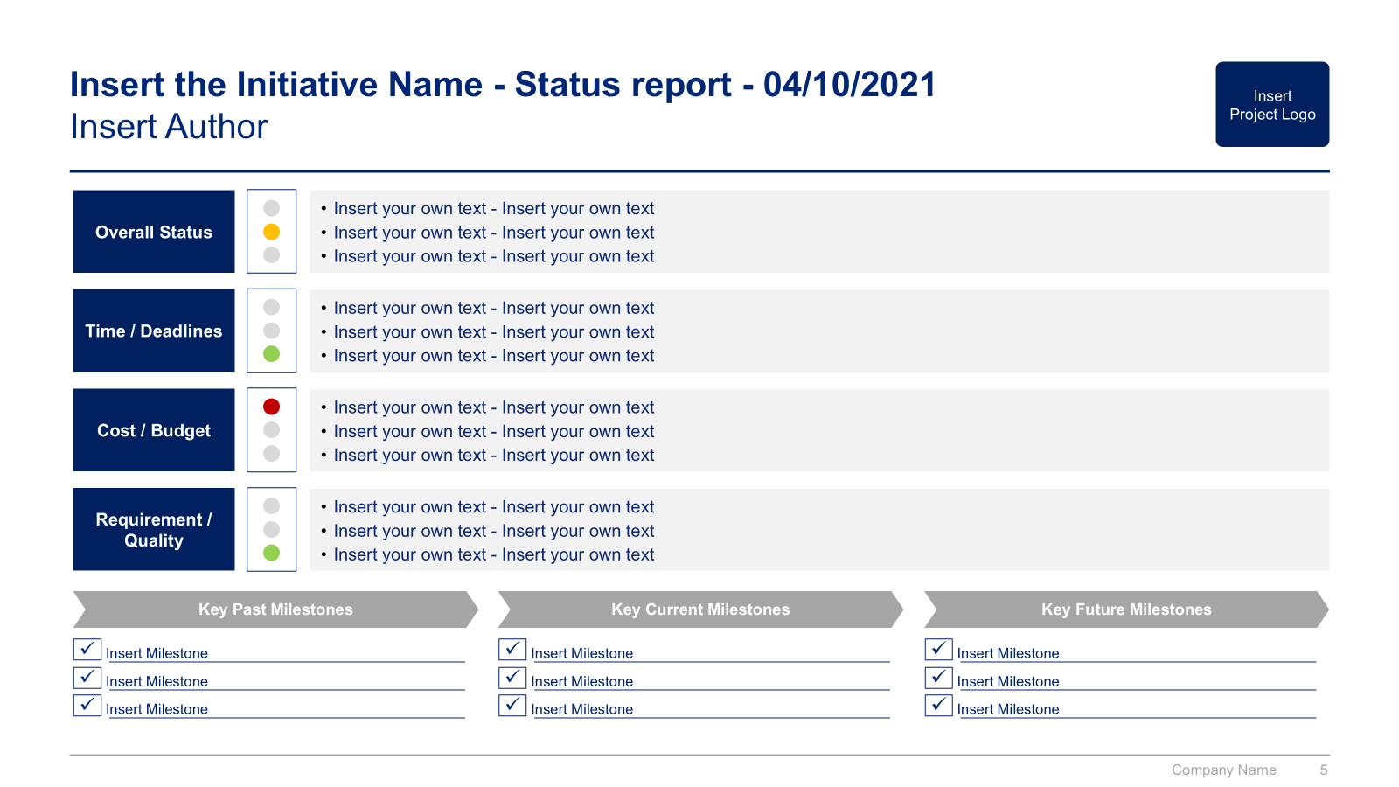
Small preview of the phase 7 ‘Strategic Dashboards’

Slide 18



The Toolkit includes multiple PowerPoint slides, Excel sheets and Video training that you can download on your device immediately after purchase
700 editable PowerPoint slides*
30 Excel sheets*
55 minutes of Video training
Overview and Approach
Business Case for Change
Operating Model and Organization Design Pillars
List of Potential Initiatives
Business Cases and Financial Models
Project Prioritization, Business Roadmap and Implementation
Change Management, Communication & Stakeholder Engagement
Strategic Dashboards
*Please note that the number of Powerpoint slides and Excel sheets listed is the number of unique slides and sheets. For example, a Powerpoint slide that has been duplicated to facilitate our clients’ understanding only counts for one slide

Slide 19









Our Management Consulting Toolkits include 9 key benefits
Improve the growth & efficiency of your organization by leveraging Management Consulting Toolkits created by ex-McKinsey, Deloitte & BCG Consultants.
Make a great investment for your career & organization. It cost us US$8M+ over the past 10 years to create all our Toolkits. Get them for a fraction of this cost.
Get a competitive advantage. It’s like hiring Management Consultants to create all the practical Frameworks, Tools & Templates you need.
Get the job done quicker and never start from scratch again with our ready-made and fully editable Frameworks, Tools & Templates in Powerpoint & Excel.
Don't reinvent the wheel. We have already worked 30,000+ hours over the past 10 years to create all the Management Consulting Toolkits you need.
Improve the capabilities of your organization by learning how the Fortune 100 and Global Consulting Firms do it.
Decrease your costs. Hiring tier-1 Consultants for a project would cost you $300k+. Way more expensive than our Toolkits, which will last you a lifetime!
Become your organization’s subject matter expert and impress your stakeholders with world-class approaches to resolve common business problems.
Get free support and advice from our ex-McKinsey, Deloitte & BCG Management Consultants.

Slide 20
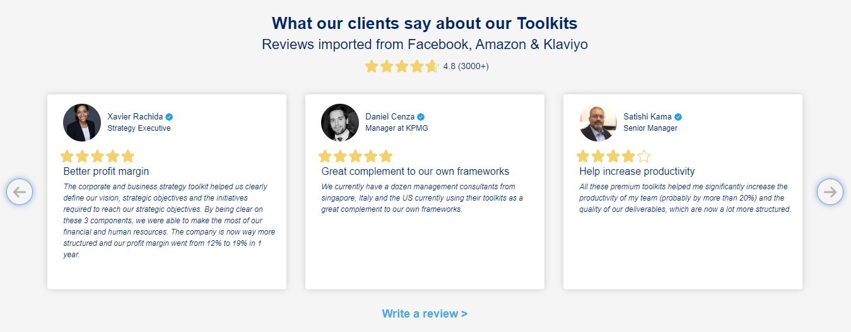
What our clients say about our Toolkits
Click here to see more reviews >

Slide 21

Join 200,000+ Executives, Consultants & Entrepreneurs leveraging our Toolkits to improve the performance of their organization
Trusted by small and large organizations
Customer satisfaction
4.8
Number of countries leveraging our Toolkits
160+
Number of professionals leveraging our Toolkits
200,000+
Daily rate of our ex-McKinsey, Deloitte and BCG Management Consultants
$3k-$4k

Slide 22
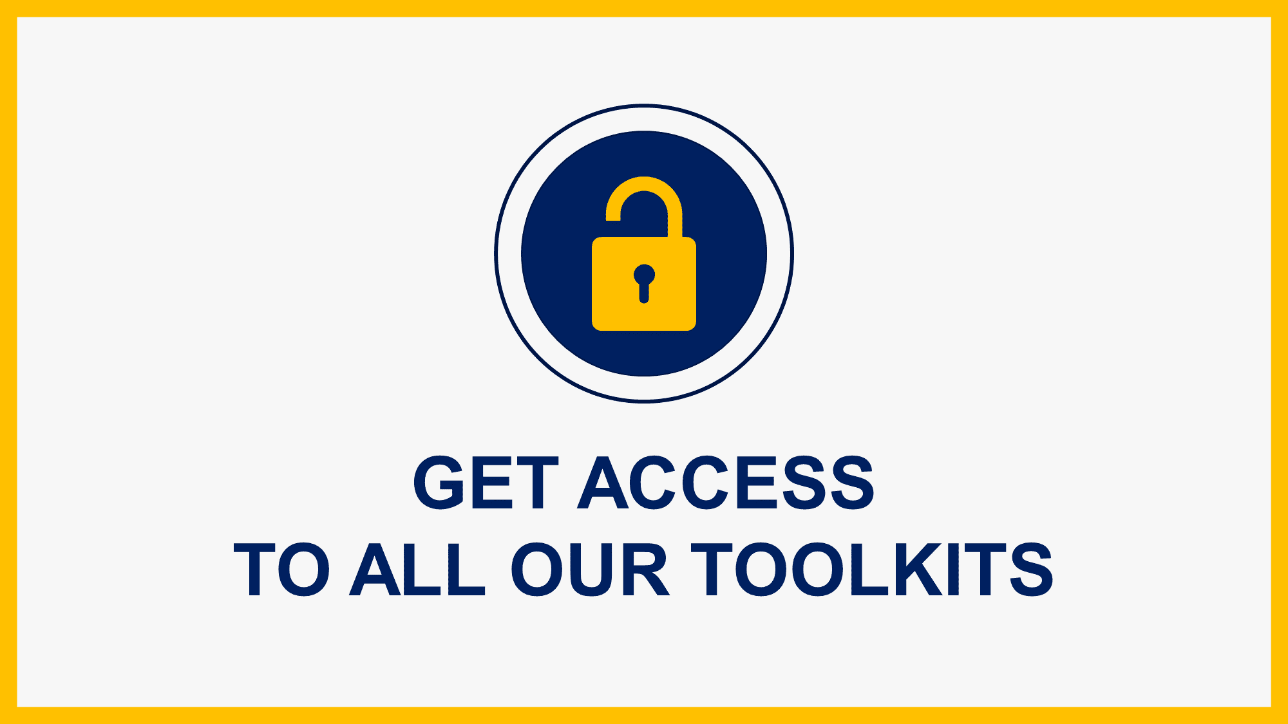
Interested in more than 1 Toolkit? Access all our Toolkits for half the price with our Gold Access
Gold Access
Click here to learn more

Slide 23

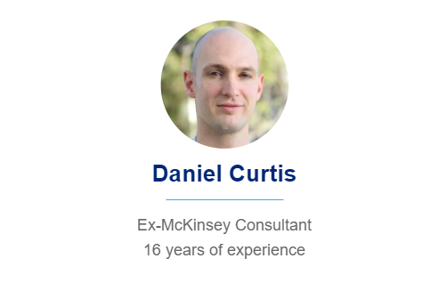
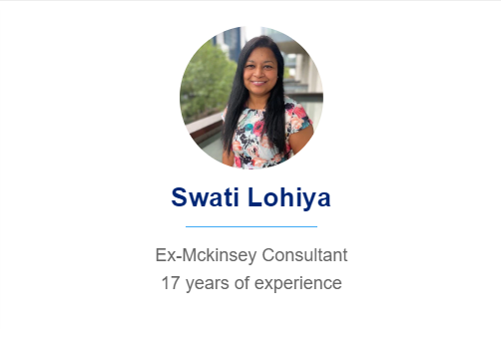

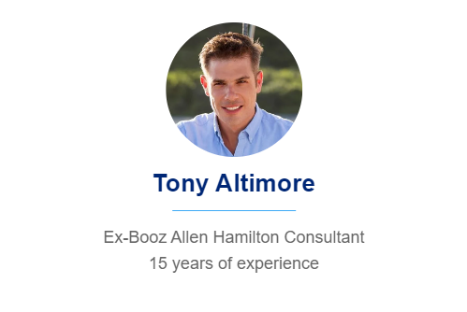
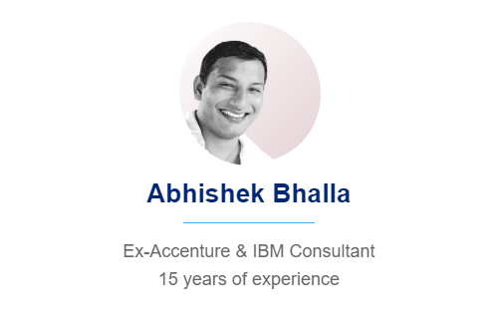
Need additional help? Send us a brief and we’ll find you the right talent from our network of 500+ tier-1 Management Consultants
Click here to send us a Project Brief

Slide 24

This was just a small preview.
www.domontconsulting.com

